Slide 1

Chernobyl Disaster
Submitted to : Rashed Hasan Ratul
Lecturer (EEE)
Dept. of CSE, UU
(Investigation)
From, “Group – C”
26 April, 1986
Ukraine, then Soviet Union

Slide 2
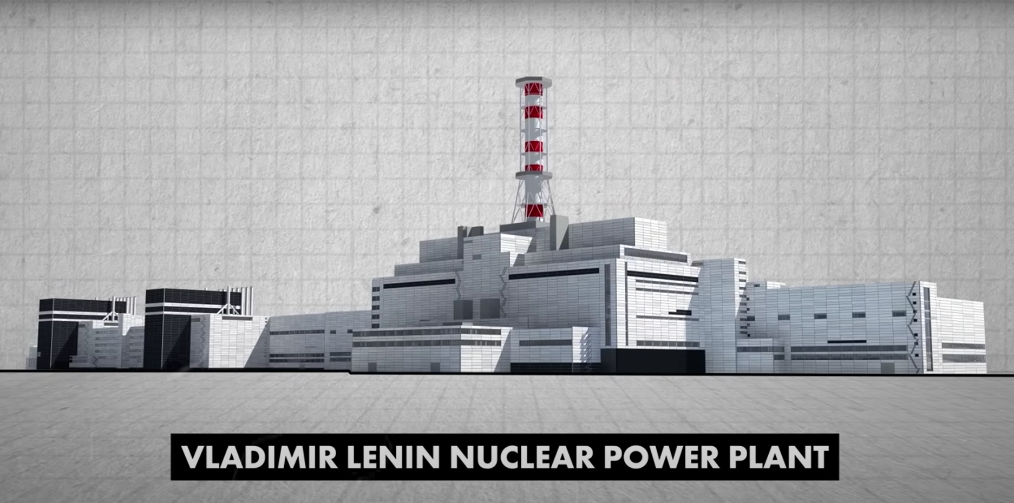
Was among one of the most advanced Nuclear Power Plants in the Soviet Union.

Slide 3
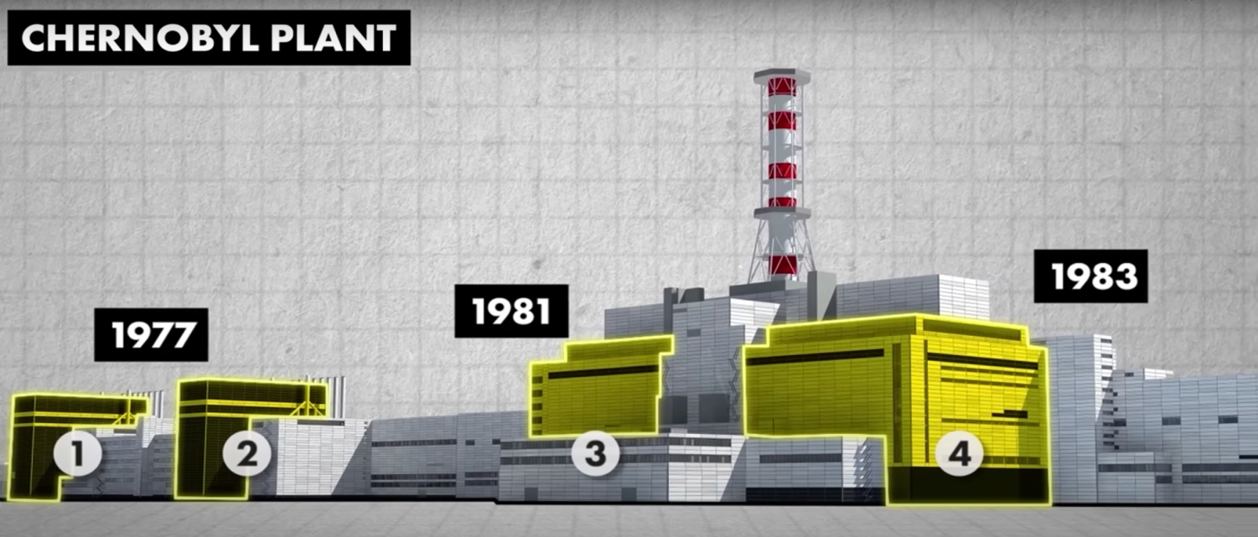
Fundamentals of Chernobyl Power Plant :
Four Nuclear Reactors ( RBMK 1000) designed.
Every Reactor had the capacity of generate 100 MW electricity. (10% of Ukraine electricity demand)

Slide 4
Reactions in Reactors of Chernobyl Power Plant :
Fuel Rods
Known as Nuclear Fuel for which Nuclear Reactions take places.
Contains : Uranium Dioxide + Uranium-235 Isotope.
Control Rods
Uses to slow down the reaction rate of Uranium-235 Fission Reaction.
Contains : Boron Carbide (Absorbs Extra Neutrons)
Moderator (RBMK-1000 Reactor)
Uses to Speed up the Fission Reaction.
Contains : Graphite Blocks. (FAULT)

Slide 5
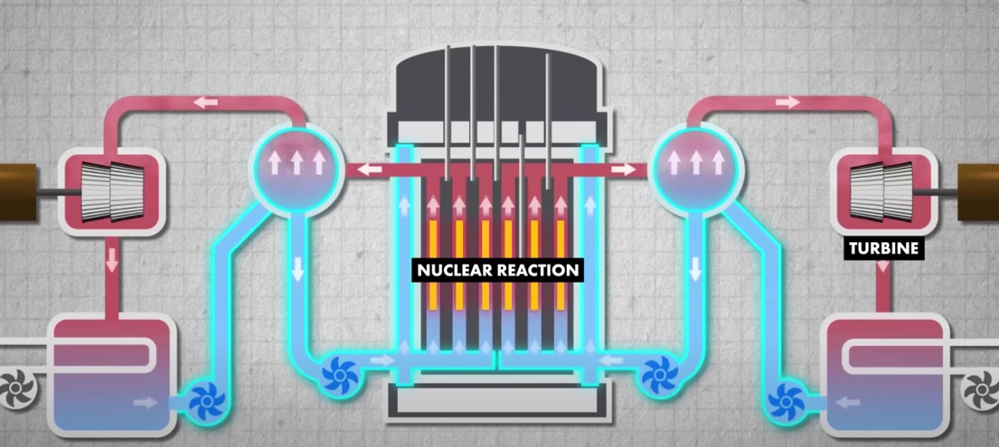
How Nuclear Reactor Works :
Reactor 4 (RBMK 1000) Facts :
Supply of water is must, so the pumps must be turned on.
BUT, WHEN IF LOAD SHEDDING ???

Slide 6
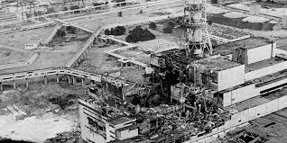
Occurance of Disaster :
It was most important to make a “Backup Diesel Generator” for generate electricity at least for 1/2 minutes to turn the Turbines.
On behalf of performing a Routine Safety Test, for some fault commands and Designing faults took a place for Nuclear explosion in Chernobyl Power Plant.
Losses of a Bioproduct (Xenon-135) which converts water to stream immediately.

Slide 7
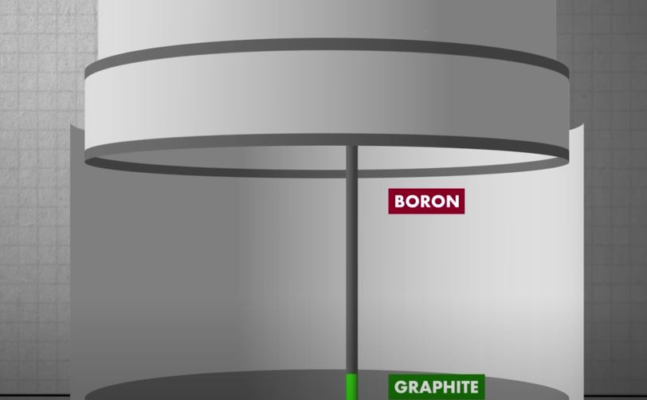
Fault in Reactor Design Flaw :

Slide 8
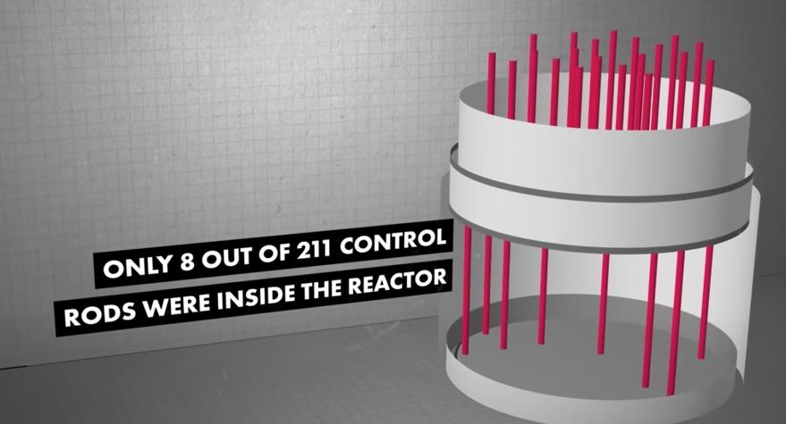
Fault of Commands :
But this is the “Violation of Safety Protocols”.
Protocol is : Minimum 15 Control Rods had to inside the Reactor.

Slide 9
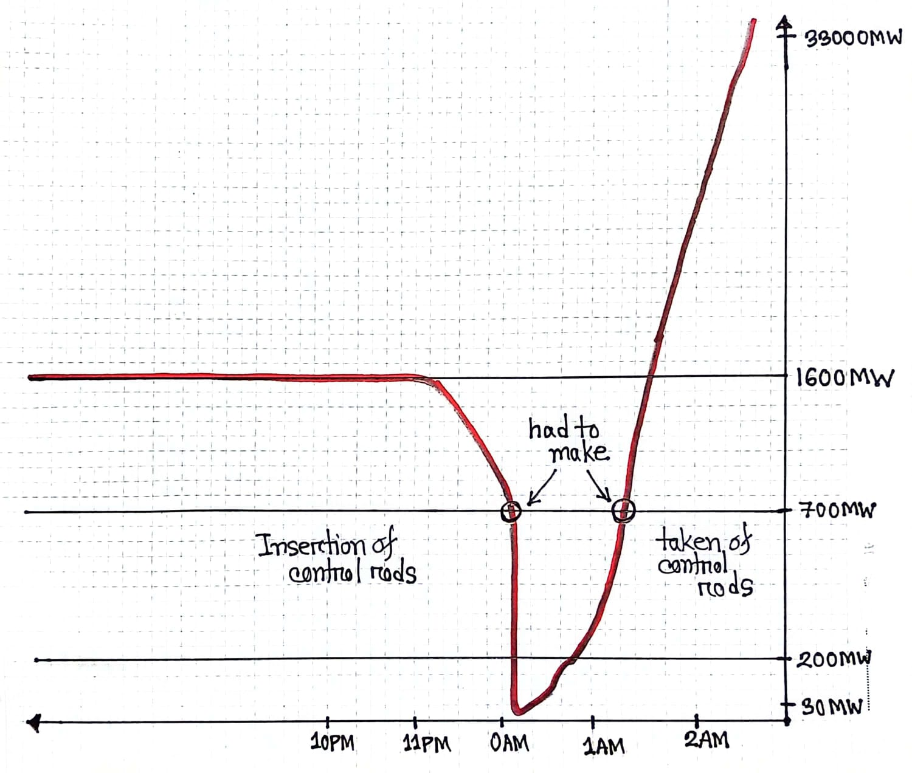
Power Generation Graph :

Slide 10
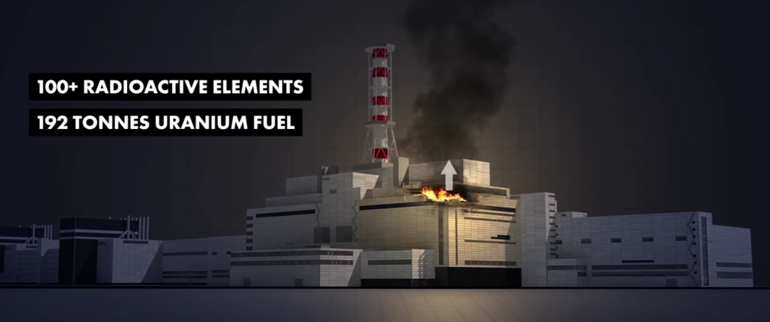
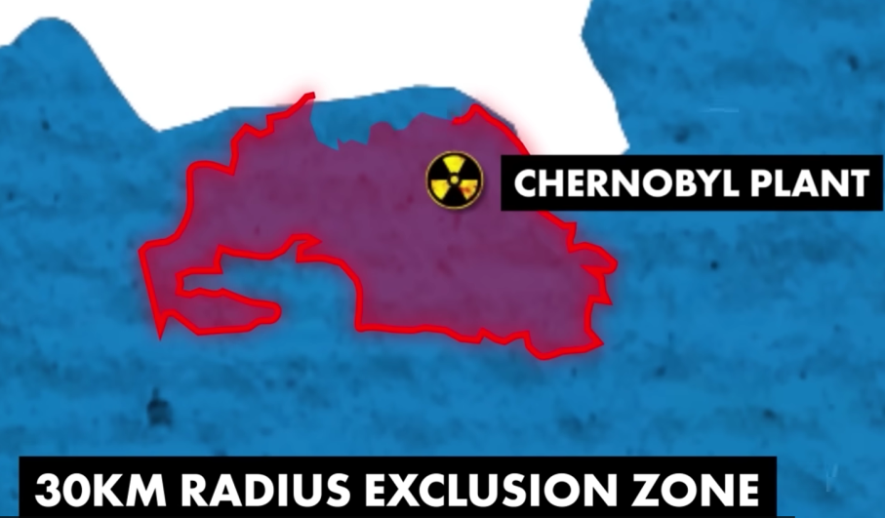
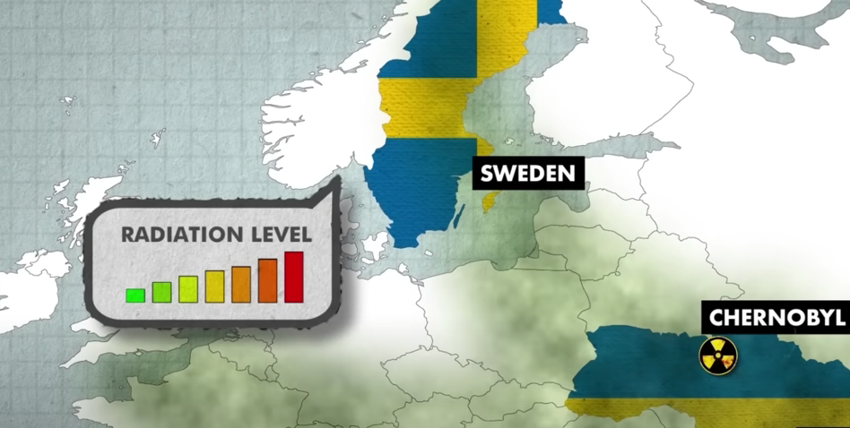
Impacts of this Explosion :

Slide 11
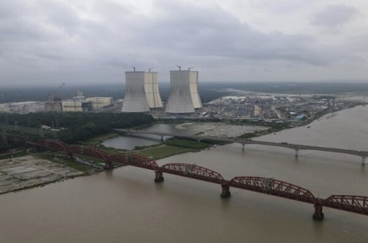
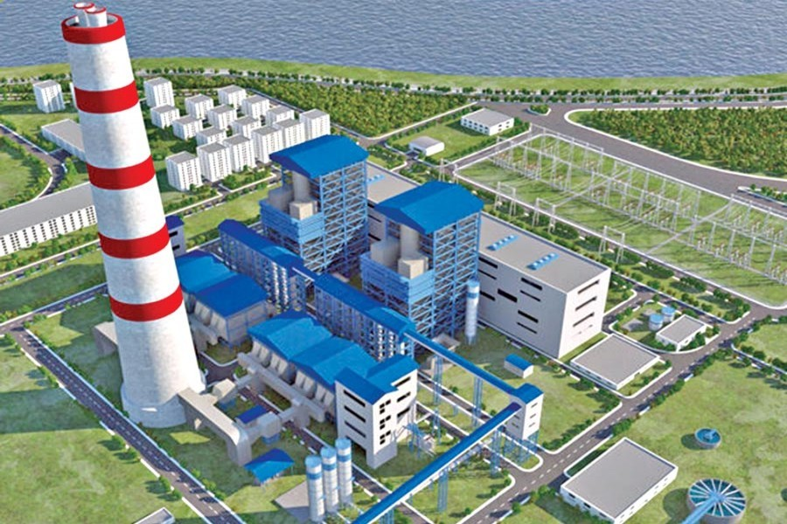
Projects in Concern for Bangladesh :
Ruppur Power Plant
Rampal Thermal Plant

Slide 12

.
Meet Our Team Members :
Md. Riad Hasan (332)
Zaki Asif (347)
Md. Tohidur Islam Jihan (337)
Lutfun Nahar Barsha (334)
Israt Jahan Tonni (359)
Tabassum Huda Nishat (333)

